Slide 1
ganiverse
a generative adversarial network (GAN) to create never seen celestial bodies that might be hovering somewhere in our universe.
structure
project plan
data wrangling
GAN architecture
results
discussion
add-on: webapp w/ tensorflow-js

Slide 2
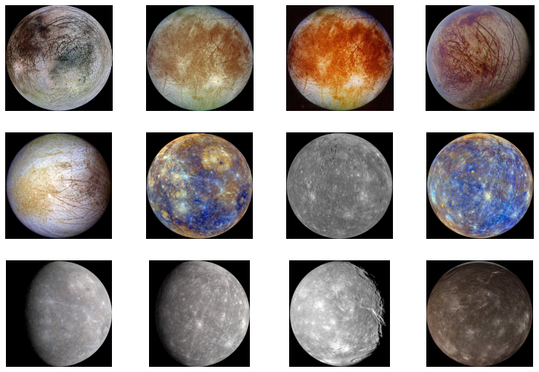
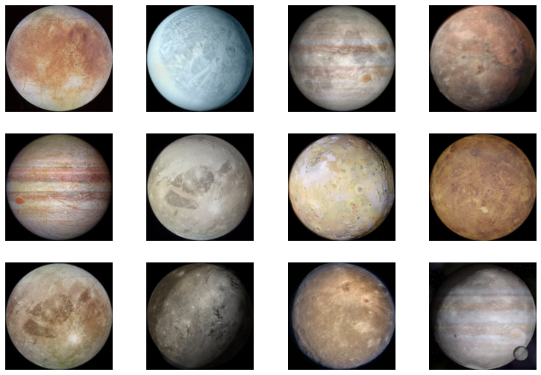
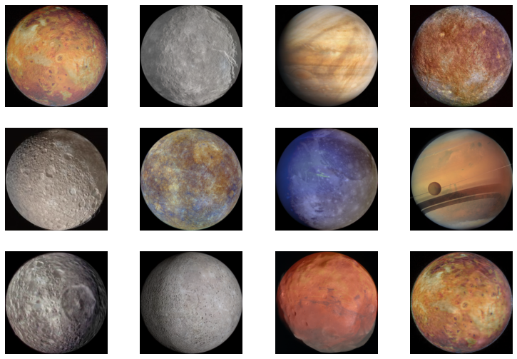
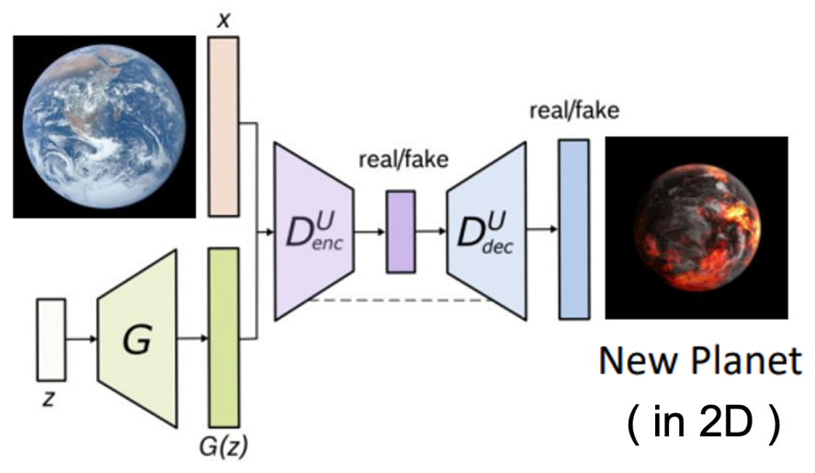
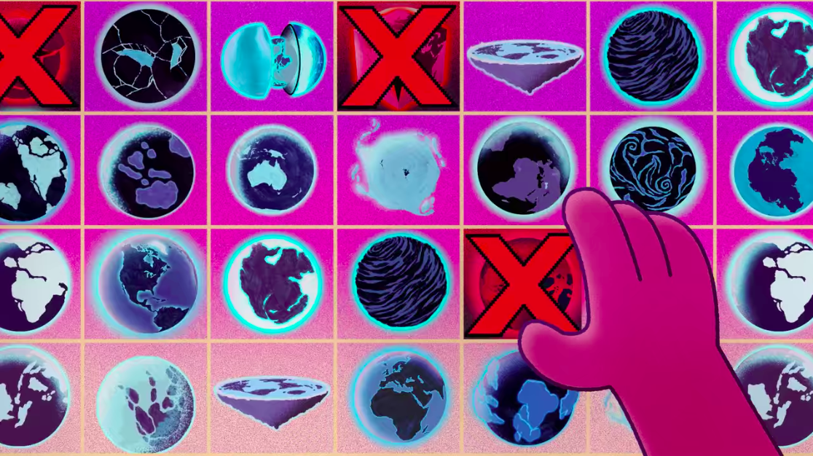
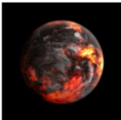
Project plan
1
2
3
Data pre-processing & augmentation
Planets and Moons
Image dataset
Train GAN to create new planet (in 2D)
4
5
Interactive web application using Tensorflow-JS
. loading models
. create planets on the go
Apply Super-Resolution CNN
to scale images

Slide 3
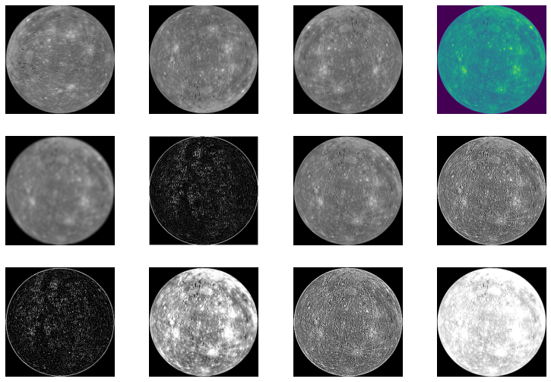
Data pre-processing
& augmentation
Mix-up¹ generated (via interpolation)
m = 3400
Training Data
n
+ m
-----
N = 5000
Planets and Moons
31 celestial objects, 5-6 images each
n = 160
Augmentation methods
n * 10 = 1600

Slide 4
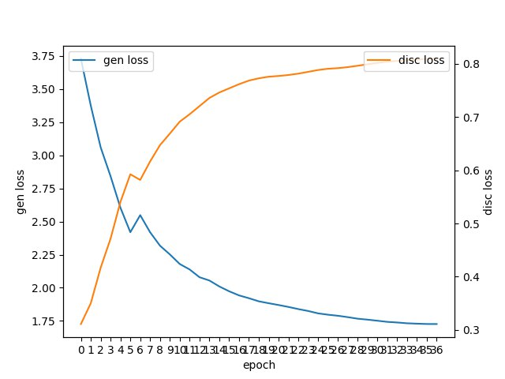
GAN architecture
generator
input: random noise
layers:
output: image 500x500
loss:
discriminator
input: image
layers:
output: sigmoid activation
loss:
competing
training: 200 epochs
losses decrease

Slide 5
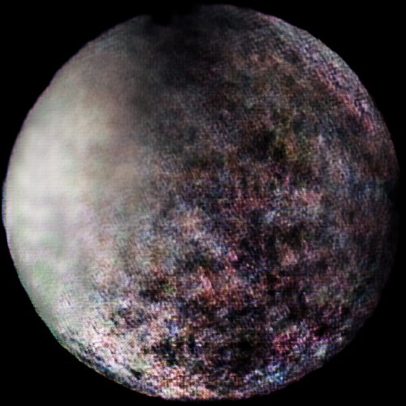
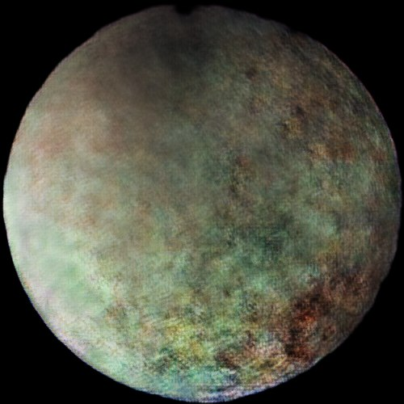
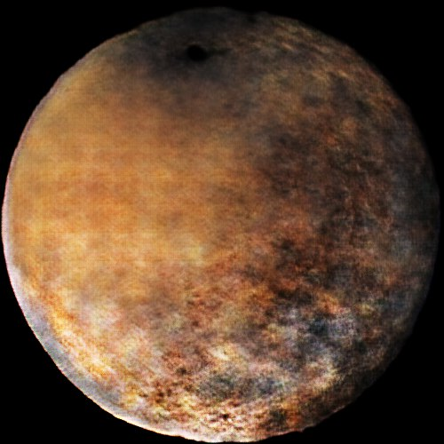
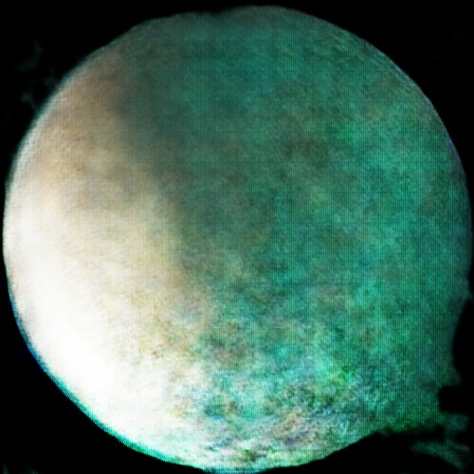
results
enhancing images:
circle cut-out
smoothing
scaling

Slide 6
discussion
could we have used a different architecture to gain better results?
are these planets realistic?
any related work?
future projects/ideas?

Slide 7
add-on: live webapp
tensorflow-js to load models
(generator)
(super resolution CNN) - pretrained
name_generator() to come up with fictive names
find_dominant_color() to display planet name in most apparent color
http://www.theseplanetsdonotexist.com/
https://github.com/avocardio/ganiverse
twitter: @theganiverse Ganiverse300
(one new planet every week)

